Slide 1
Security in Cloud Computing
Group Members
Shehnaz Bibi 01-243211-011
Shahid Hussain 01-243211-009
Arsalan Ali 01-243211-002

Slide 2

Outline
Introduction
Security Issues in Cloud Computing
Possible Solutions

Slide 3

1- Introduction
Why and what's cloud security?
Public, private or hybrid?
Is cloud security is really concern?
How secure would u make your application?

Slide 4


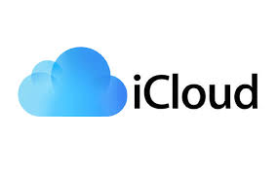
Why cloud security?

Slide 5

What's cloud security?
It’s the use of latest technologies and security tecniquies to protect your data, application and infrastructure with cloud computing.

Slide 6
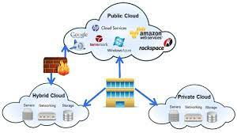
Hybrid, public or private?

Slide 7
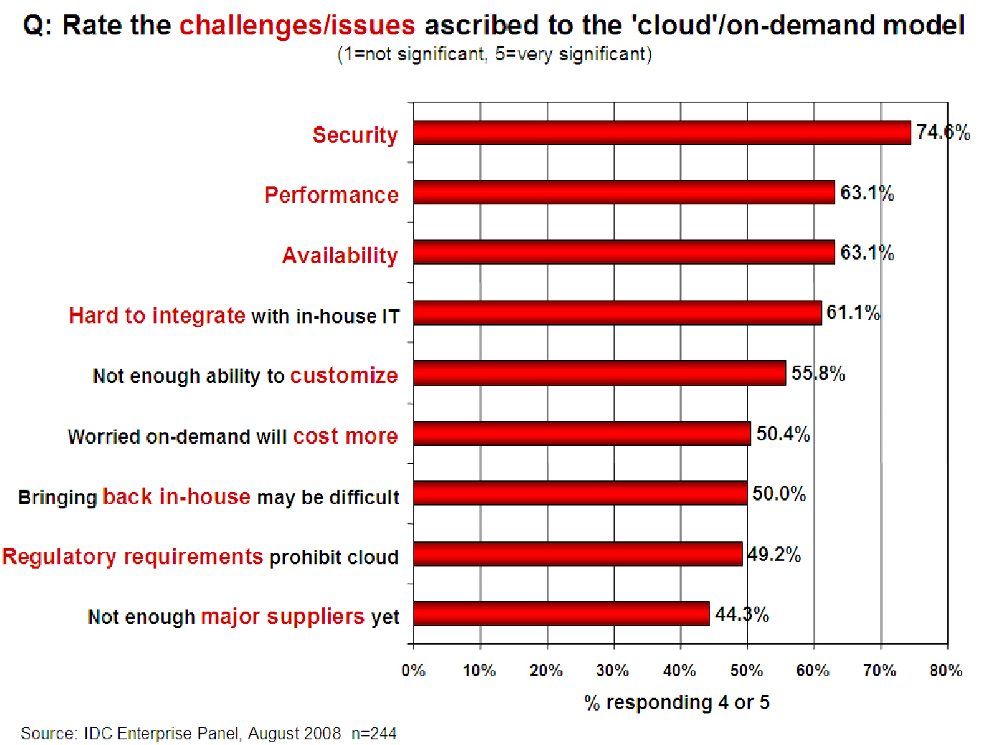
Companies are still afraid to use clouds

Slide 8
Cloud Security Issues and Threats

Slide 9
Misconfiguration
Cloud misconfiguration causes data breaches
  Unfamiliar with securing cloud infrastructure
  Cloud data breaches 80%
Cloud misconfiguration risk is probably employee’s fault
  99% of cloud failures will be down to human error.
  Due to complexity
  Allow unrestricted access
  AWS bucket permissions (40%)
DevOps and Security need to work as one
  Security and DevOps working as a team
  This approach, commonly known as “Shift left”

Slide 10
Unauthorized Access
Outside the network perimeter directly accessible from the public Internet
Improperly-configured security
Compromised credentials
Attacker to gain direct access,

Slide 11
Insecure Interfaces/APIs
As dependency on APIs increases
Cybercriminals have found two common ways to leverage them for malicious purposes
  Exploitation of Inadequate Authentication
  Profiting from Increased Use of Open-Source Software

Slide 12

Data Loss/Leakage
Unauthorized transmission of data
The Accidental Breach

Slide 13
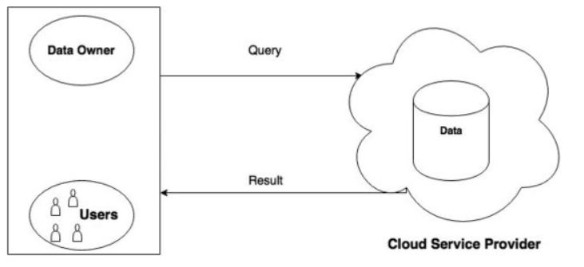
Data Privacy/Confidentiality
Data privacy and confidentiality is a major concern for many organizations
Database outsourcing database as a service (DBaaS)

Slide 14
Accidental Exposure of Credentials
Phishers commonly use cloud applications in their phishing attacks.
Document sharing services (Google Drive, Dropbox, OneDrive)

Slide 15
Possible Solutions

Slide 16
Possible Solutions
Deploy Multi-Factor Authentication(MFA)
  Extra Layer of security
Shared Responsibility model
  Customer VS Cloud Providers
Advance Networking services
  Virtual private cloud
  Internet gateway
  Direct connect

Slide 17
Cont..
Edge Location
  To store cache copies
  Faster delivery
Shield Protection
  Web Application Firewall(WAF)
  DDOS attacks
  Use variety of analysis techniques

Slide 18
Cont…
Provide Anti-Phishing Training for Employees on a Regular Basis.
Manage Your User Access to Improve Cloud Computing Security.
Cloud migration solutions
  SnowCone
  SnowBall
  SnowMobile

Slide 19
Thank You

